Slide 1
Word Problems with LLM

Slide 2
Word Problems with LLM
Datasets
Better Inference Methods
Attacks/Evaluation

Slide 3
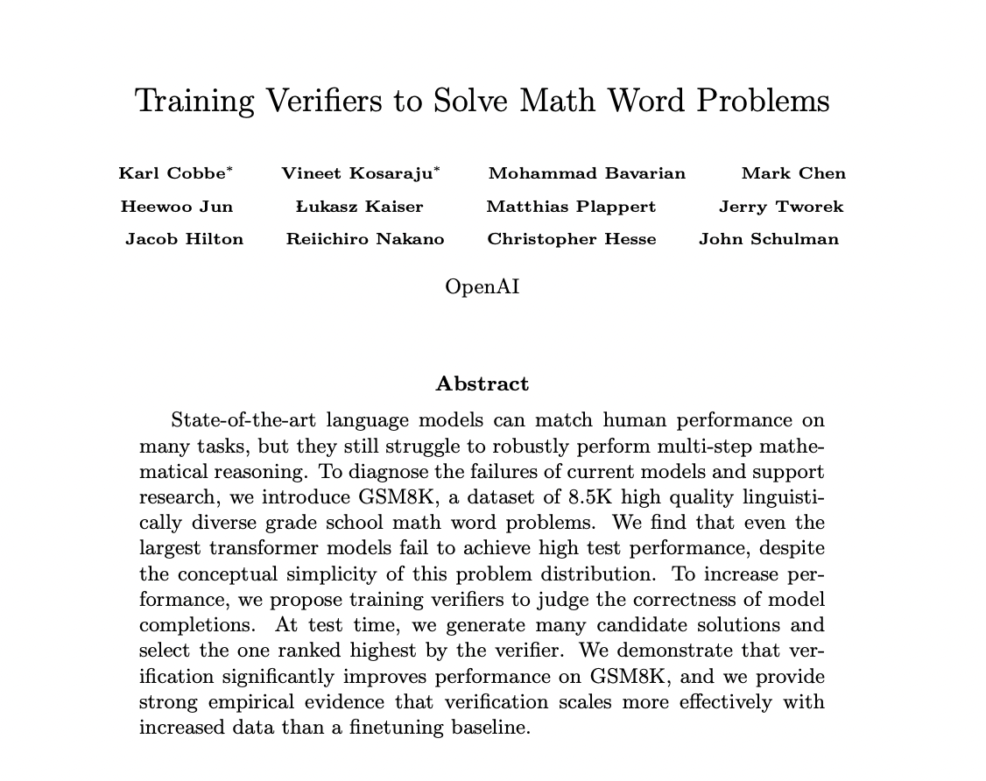
Paper Title : Training Verifiers to Solve Math Word Problems Category : Inference Methods, Dataset From : OpenAI
Key Contributions
Introduced GSM8K, a dataset of 8.5K high quality linguistically diverse grade school math word problems.
Propose training verifiers to judge the correctness of model completions.
https://arxiv.org/pdf/2110.14168.pdf

Slide 4
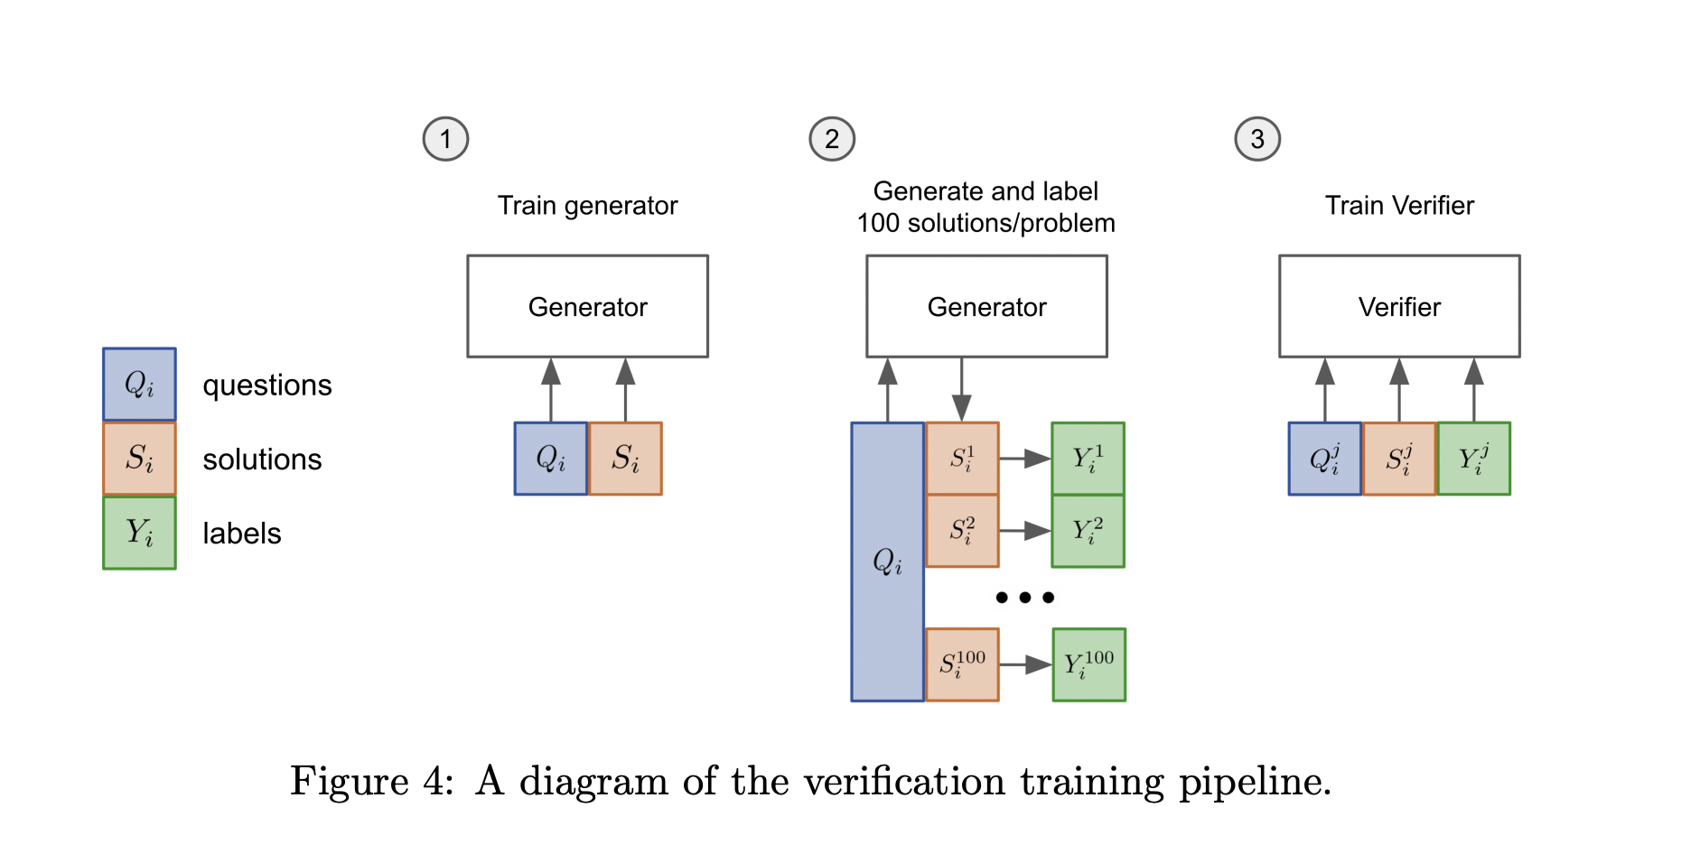
Paper Title : Training Verifiers to Solve Math Word Problems Category : Methods to improve accuracy, Dataset From : OpenAI
Train the verifier
Finetune a model (the “generator”) for 2 epochs on the training set.
Sample 100 completions from the generator for each training problem and label each solution as correct or incorrect.
Train a verifier for a single epoch on this dataset.

Slide 5
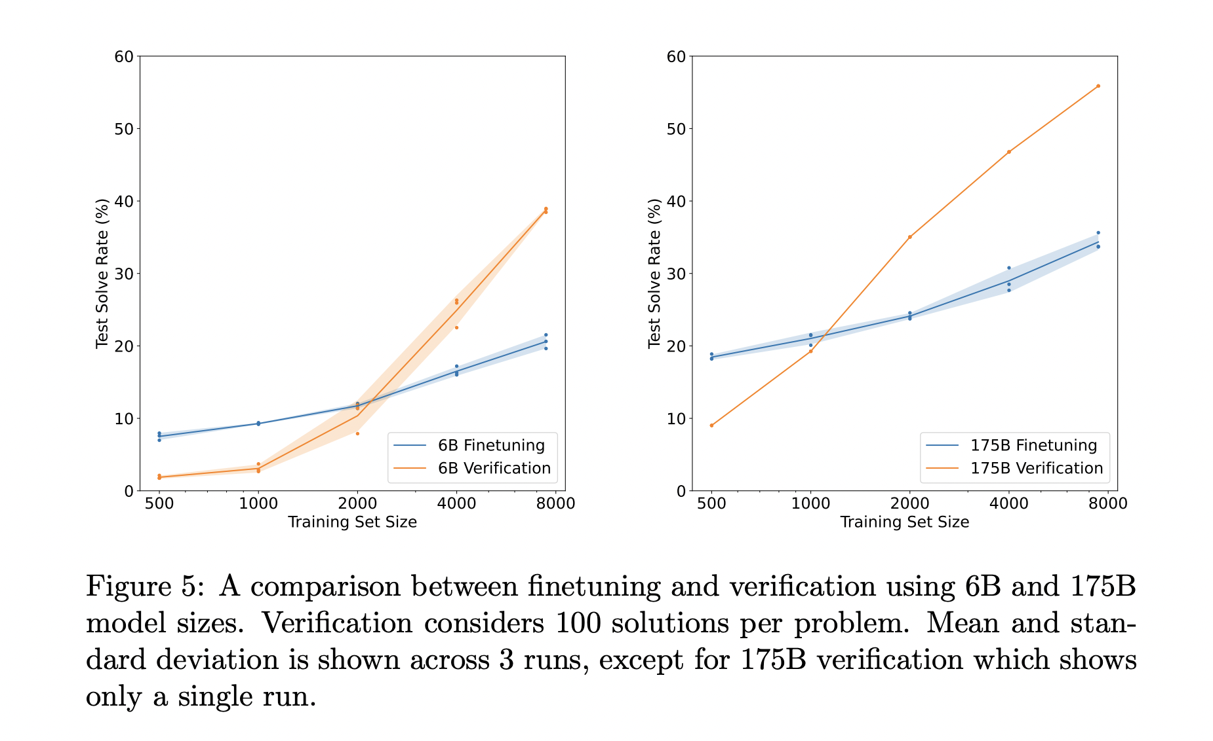
Paper Title : Training Verifiers to Solve Math Word Problems Category : Methods to improve accuracy, Dataset From : OpenAI

Slide 6
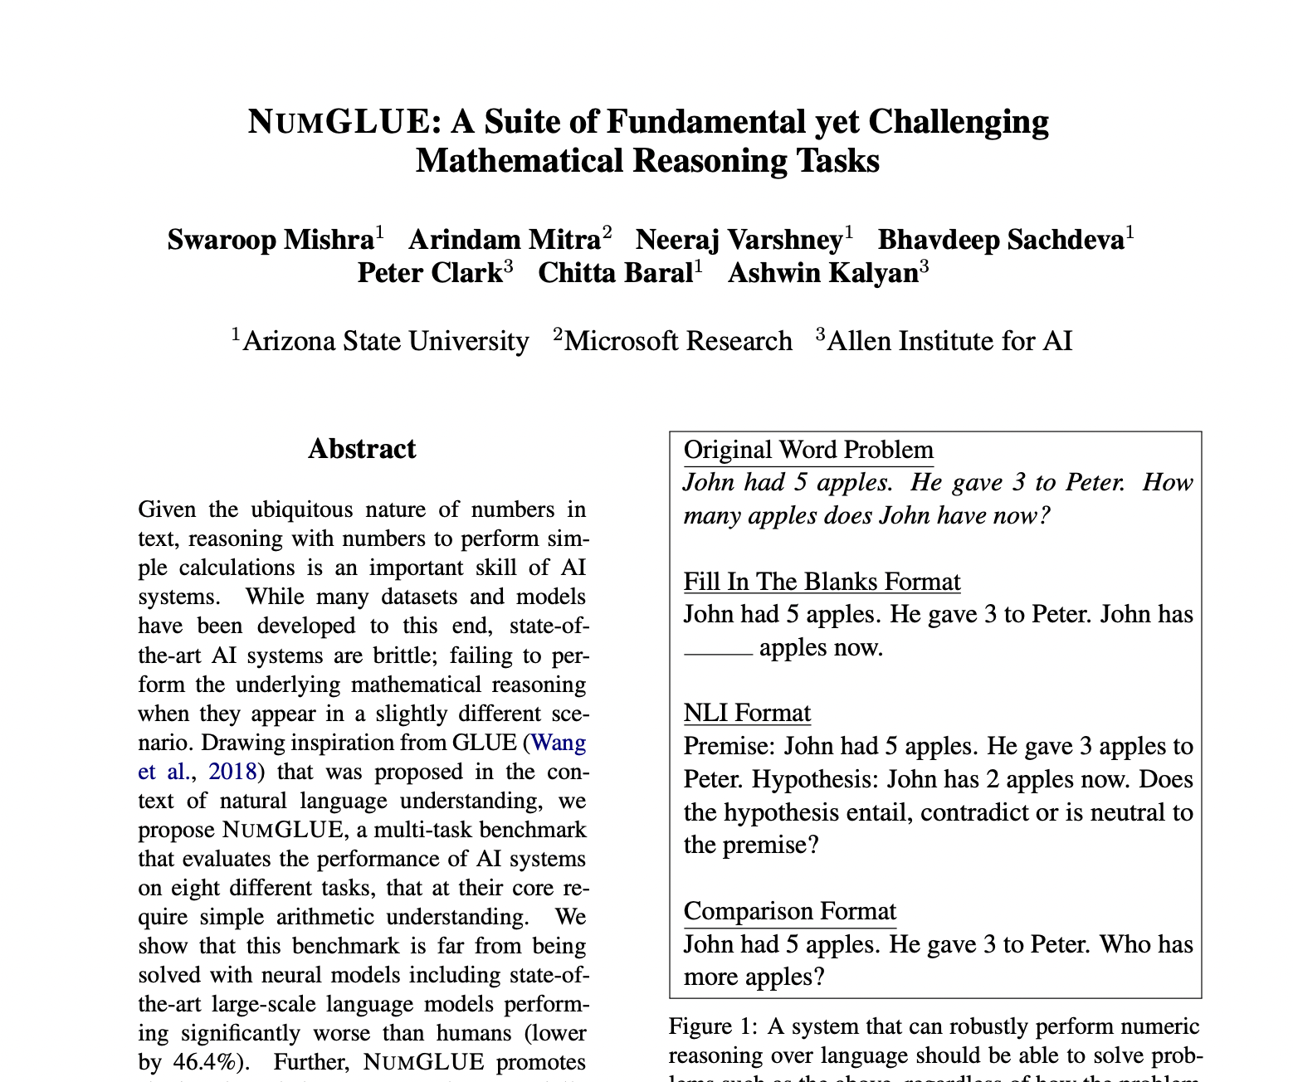
Paper Title : NUMGLUE: A Suite of Fundamental yet Challenging Mathematical Reasoning Tasks Category : Dataset
From : Arizona State University, Microsoft Research,Allen Institute for AI
Key Contributions
Introduced NUMGLUE– a multi-task benchmark consisting of eight different tasks, including 4 new ones, whose solution at its core requires an understanding of simple arithmetic.
Propose a memory-augmented neural model to demonstrate the utility of such a multi-task meta dataset.
https://aclanthology.org/2022.acl-long.246.pdf

Slide 7
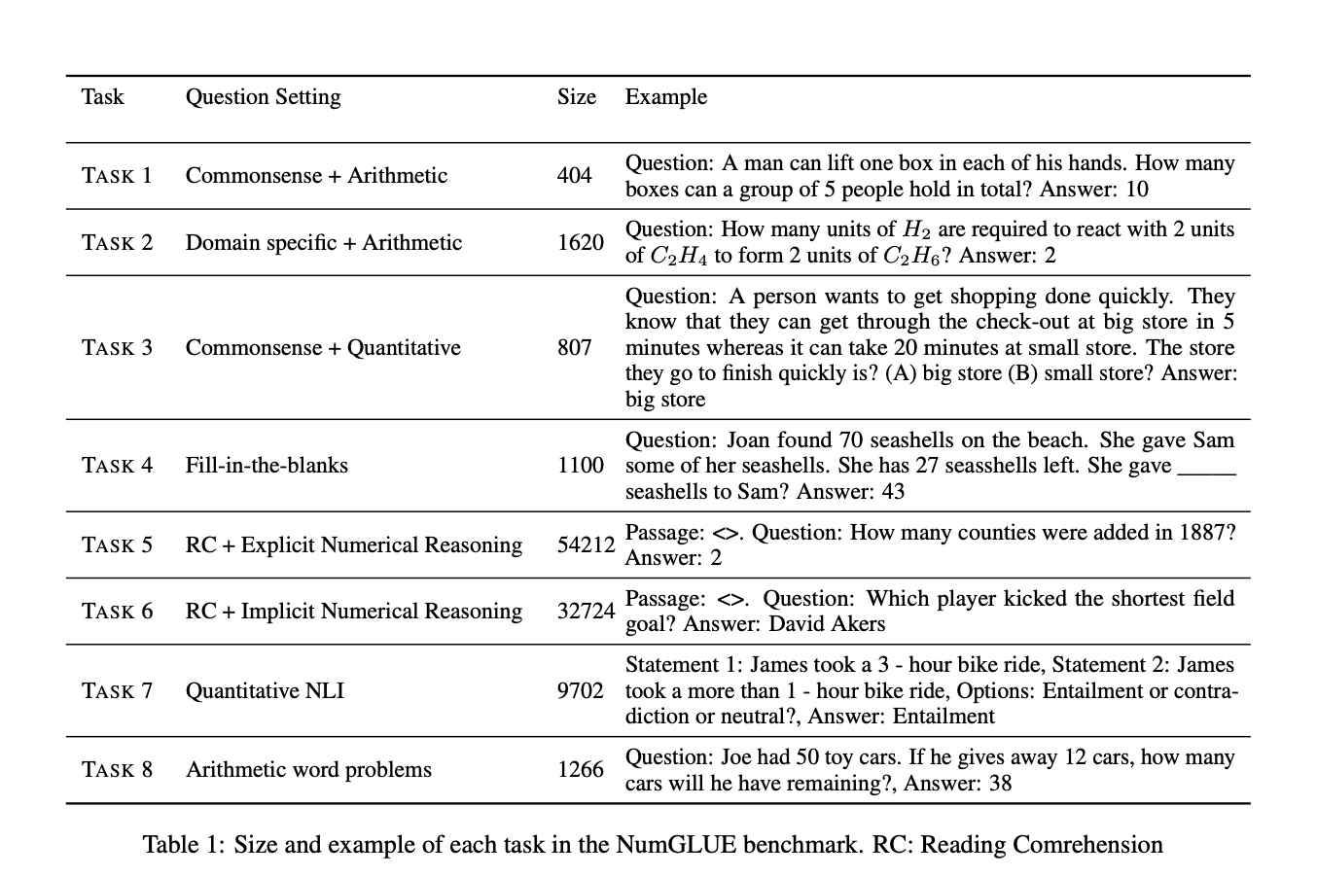
Paper Title : NUMGLUE: A Suite of Fundamental yet Challenging Mathematical Reasoning Tasks Category : Dataset
From : Arizona State University, Microsoft Research,Allen Institute for AI

Slide 8
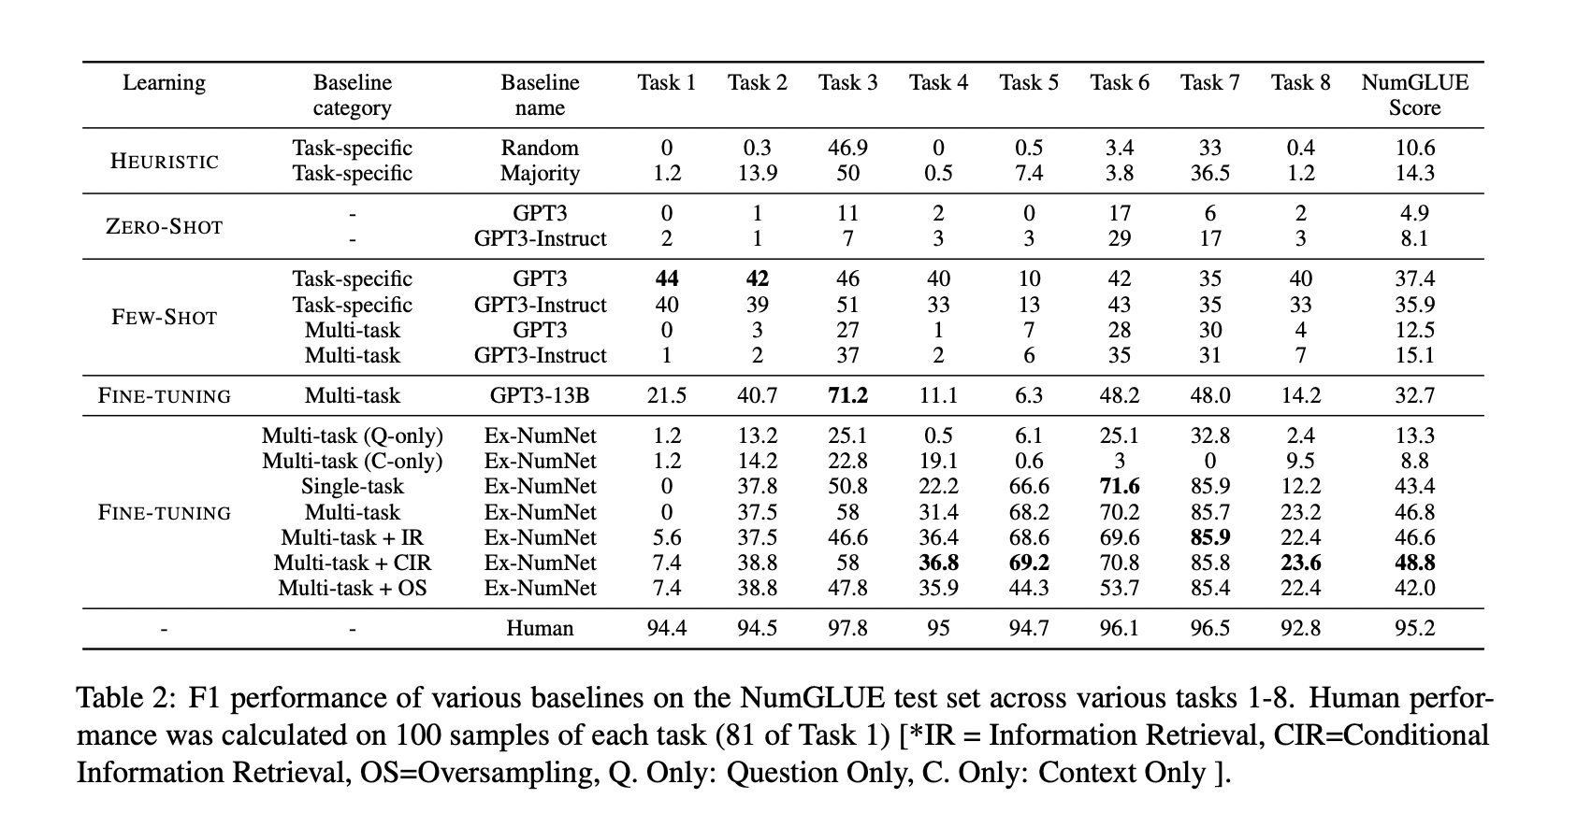
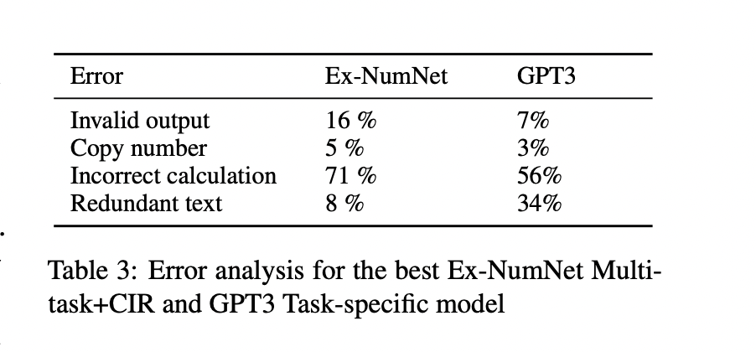
Paper Title : NUMGLUE: A Suite of Fundamental yet Challenging Mathematical Reasoning Tasks Category : Dataset
From : Arizona State University, Microsoft Research,Allen Institute for AI

Slide 9
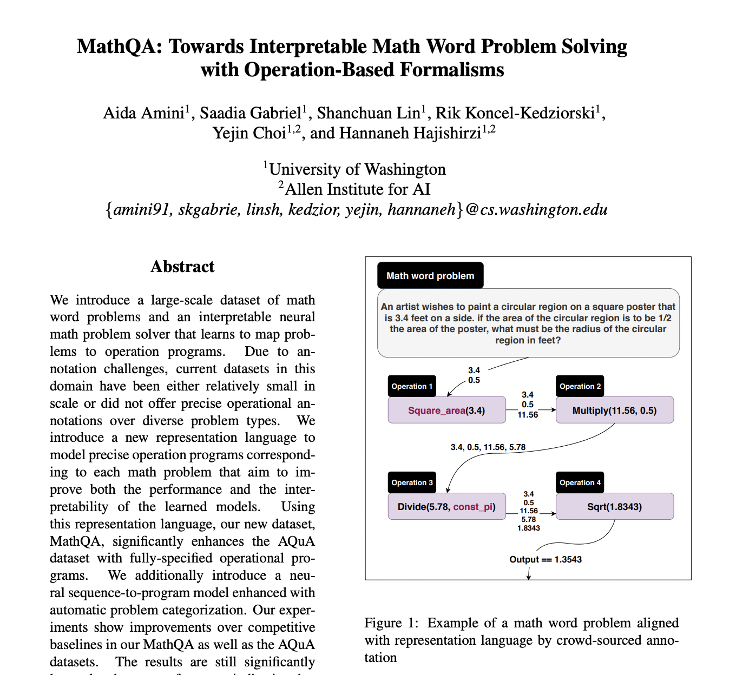
Paper Title : MathQA: Towards Interpretable Math Word Problem Solving with Operation-Based Formalisms Category : Dataset
From : Allen Institute for AI
Key Contributions
Introduced a large-scale dataset of math word problems that are densely annotated with operation programs
Introduce a neural architecture leveraging a sequence-to-program model with automatic problem categorization
https://aclanthology.org/N19-1245.pdf

Slide 10
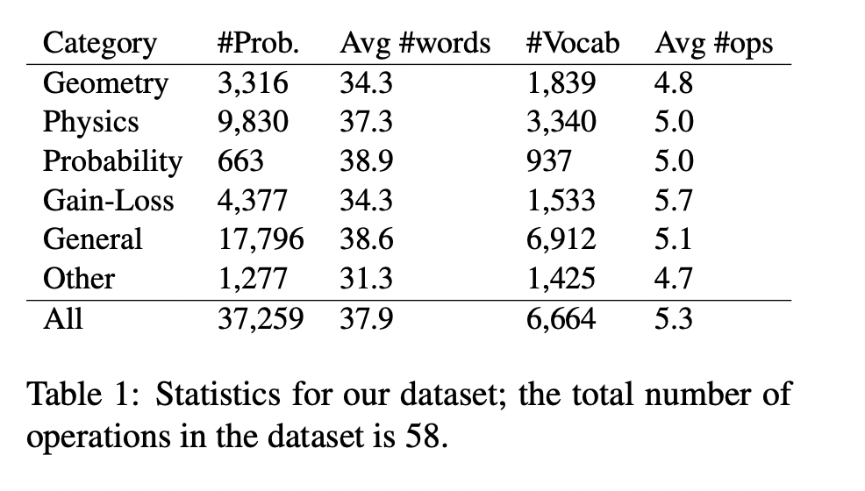
Paper Title : MathQA: Towards Interpretable Math Word Problem Solving with Operation-Based Formalisms Category : Dataset
From : Allen Institute for AI

Slide 11
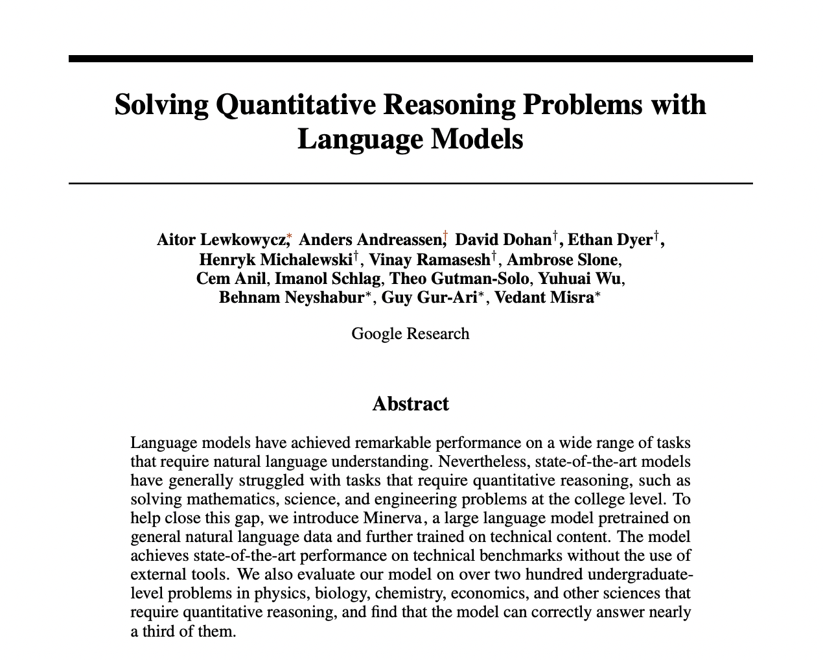
Paper Title : Solving Quantitative Reasoning Problems with Language Models Category : Dataset
From : Google Research
Key Contributions
Presented Minerva, a language model that achieves strong performance on many quantitative reasoning tasks.
Build a dataset of over 200 undergraduate-level questions in science and mathematics from MIT’s OpenCourseWare (OCW), This provides a measure of our model’s quantitative reasoning abilities in a chain-of-thought context beyond a pure mathematical setting.

Slide 12
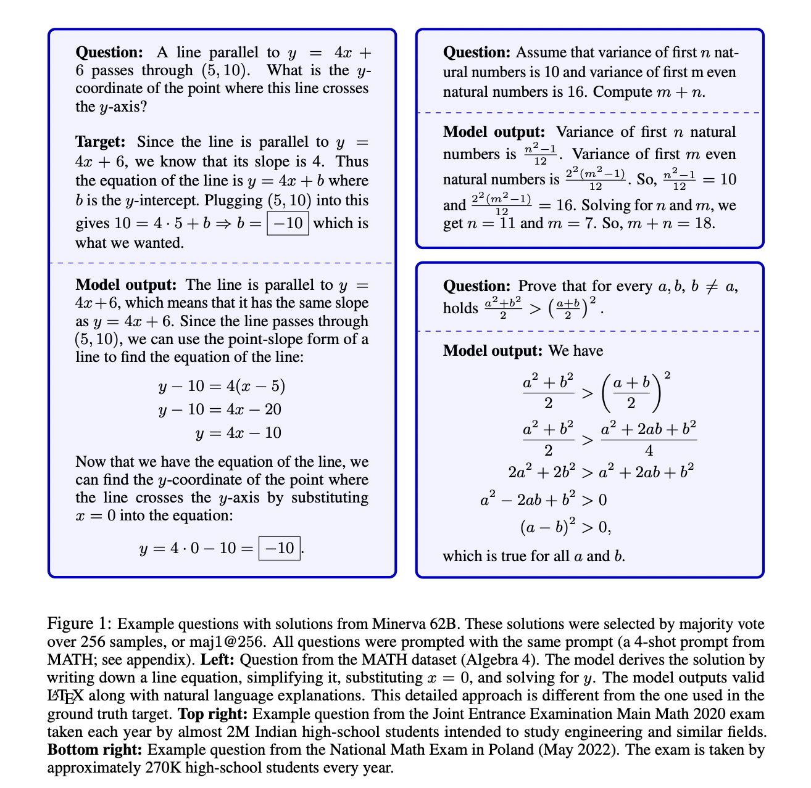
Paper Title : Solving Quantitative Reasoning Problems with Language Models Category : Dataset
From : Google Research

Slide 13
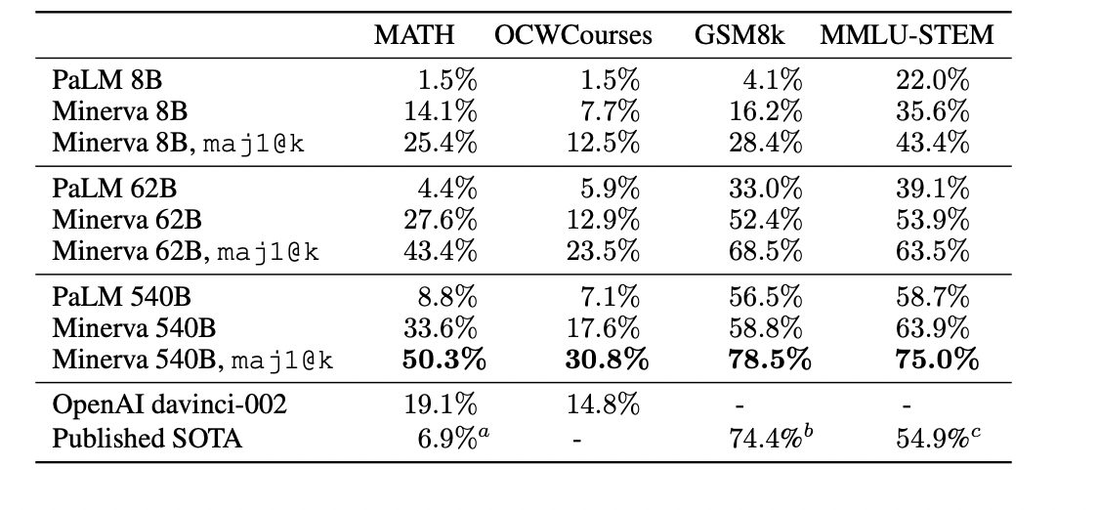
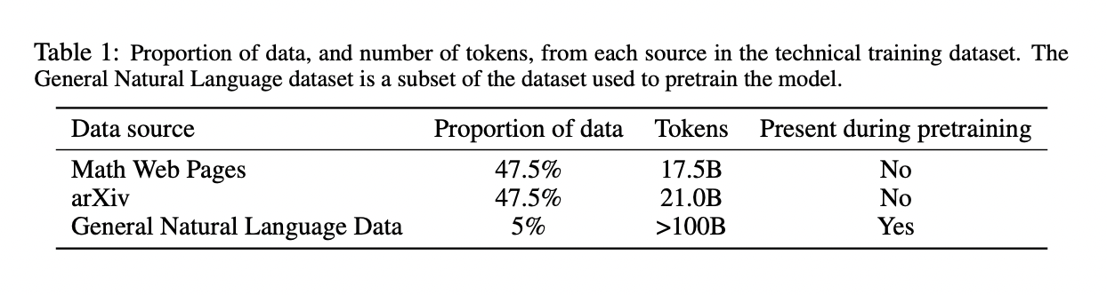
Paper Title : Solving Quantitative Reasoning Problems with Language Models Category : Dataset
From : Google Research

Slide 14
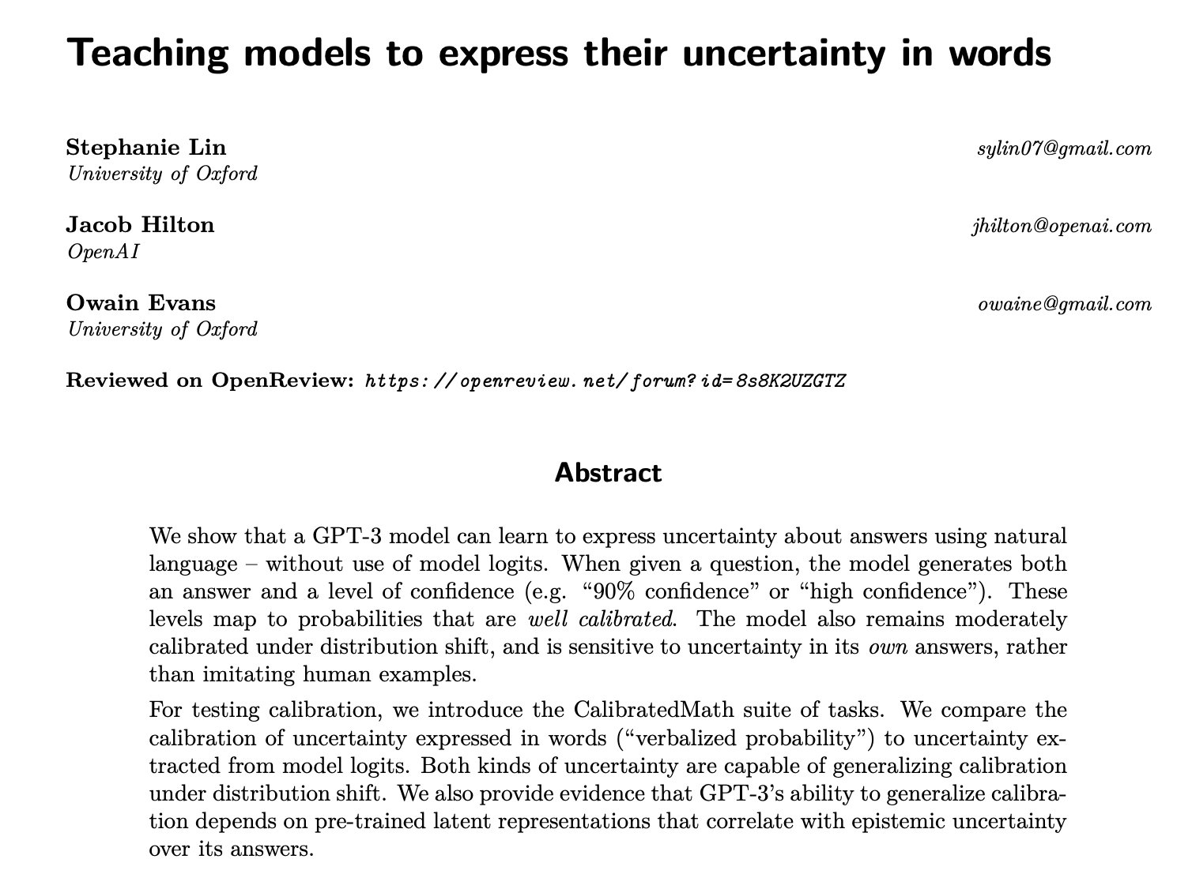
Paper Title : Teaching models to express their uncertainty in words Category : Dataset
From : OpenAI
Key Contributions
CalibratedMath is a suite of elementary mathematics problems. For each question, a model must produce both a numerical answer and a confidence in its answer
GPT-3 can learn to express calibrated uncertainty using words (“verbalized probability”)
https://openreview.net/pdf?id=8s8K2UZGTZ

Slide 15
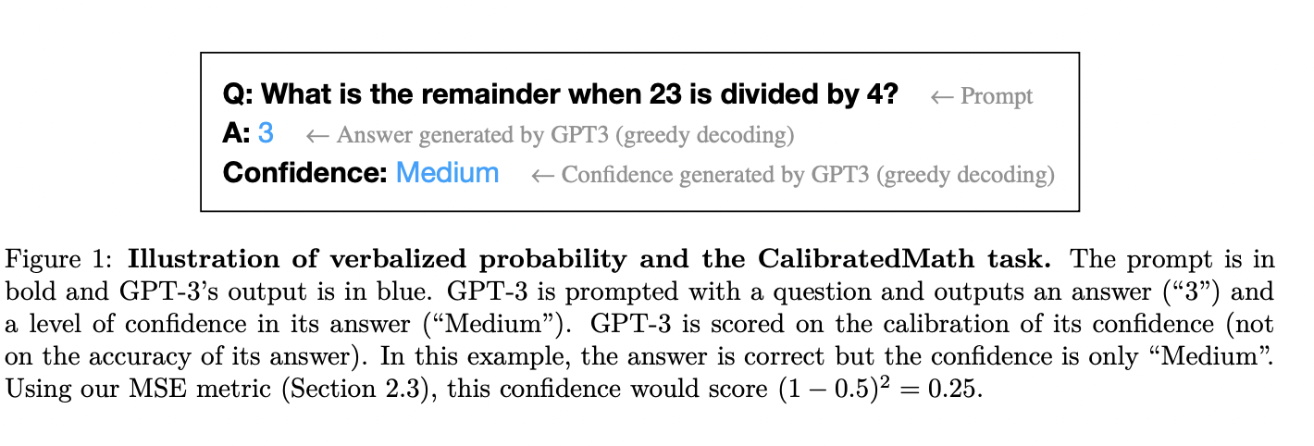
Paper Title : Teaching models to express their uncertainty in words Category : Dataset
From : OpenAI

Slide 16
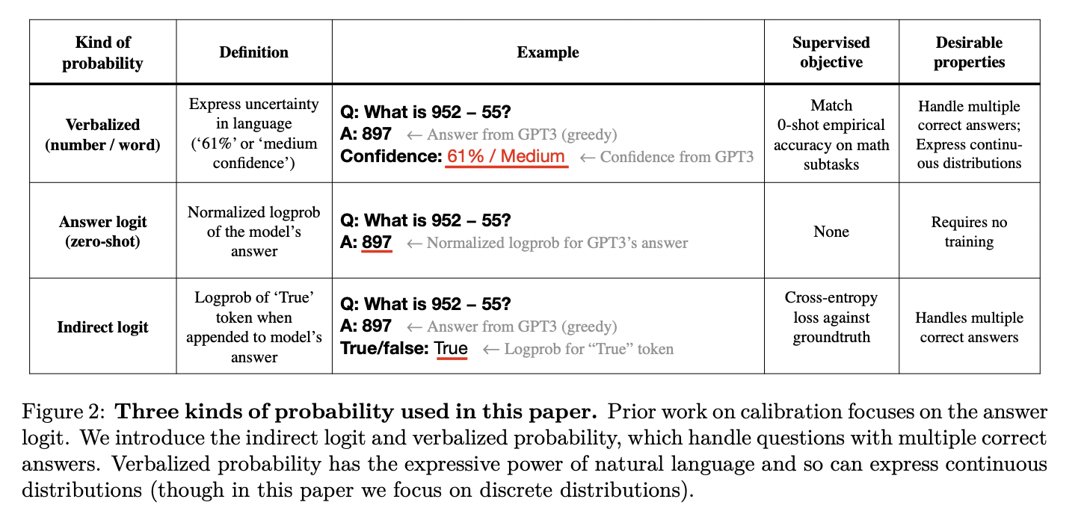
Paper Title : Teaching models to express their uncertainty in words Category : Dataset
From : OpenAI

Slide 17
Paper Title : Teaching models to express their uncertainty in words Category : Dataset
From : OpenAI
Does GPT-3 just learn to output the logits?
Does GPT-3 just learn simple heuristics (e.g. low probability for questions with large integers)?
Evidence that GPT-3 uses latent (pre-existing) features of questions.

Slide 18
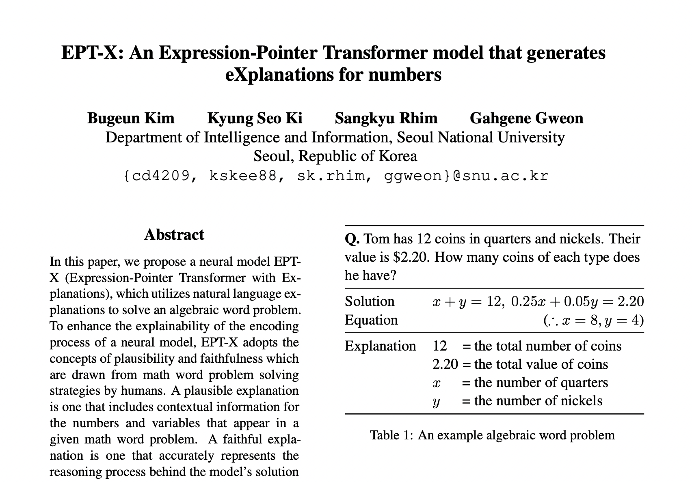
Paper Title : EPT-X: An Expression-Pointer Transformer model that generates eXplanations for numbers Category : Dataset
From : Seoul National University
Key Contributions
EPT-X model: proposed a baseline model that can generate explanations and solve algebraic word problems, in terms of correctness, plausibility, and faithfulness
New dataset: Released a novel dataset PEN (Problems with Explanations for Numbers), which expands the existing datasets by attaching explanations to each number/variable
https://aclanthology.org/2022.acl-long.305.pdf

Slide 19
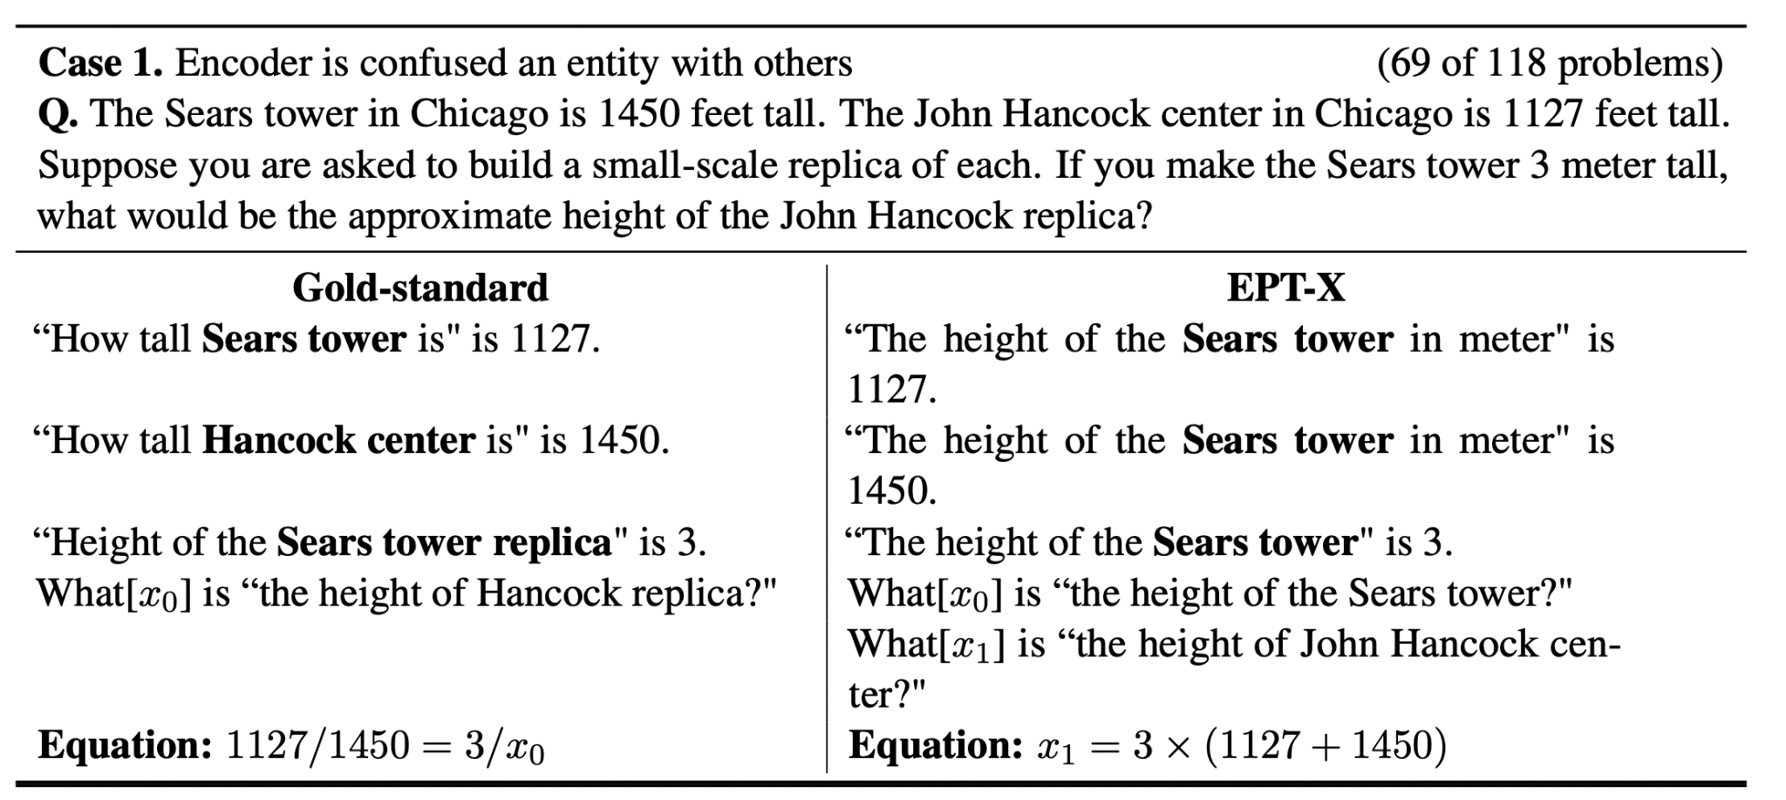
Paper Title : EPT-X: An Expression-Pointer Transformer model that generates eXplanations for numbers Category : Dataset
From : Seoul National University

Slide 20
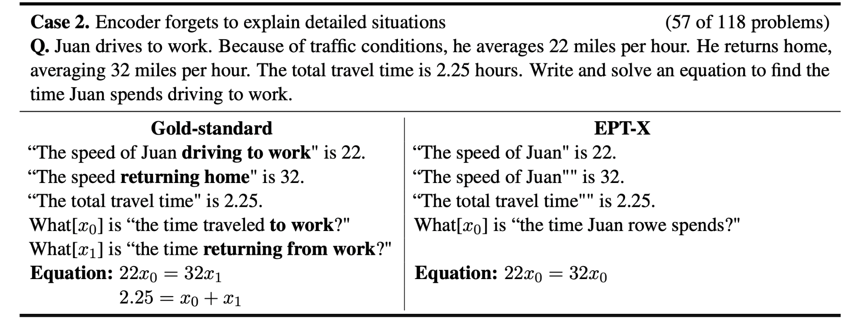
Paper Title : EPT-X: An Expression-Pointer Transformer model that generates eXplanations for numbers Category : Dataset
From : Seoul National University

Slide 21
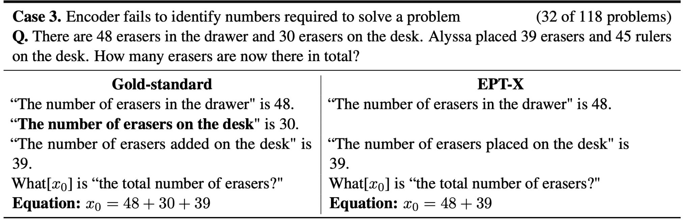
Paper Title : EPT-X: An Expression-Pointer Transformer model that generates eXplanations for numbers Category : Dataset
From : Seoul National University

Slide 22
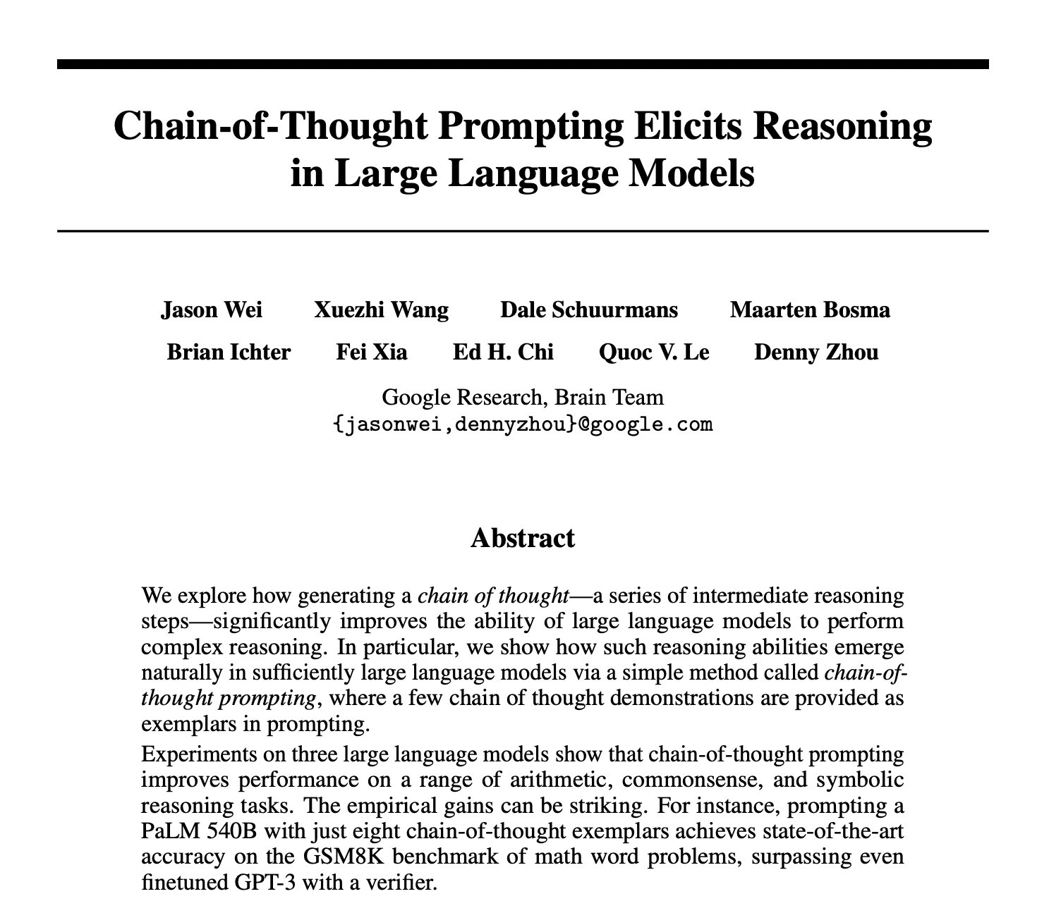
Paper Title : Chain-of-Thought Prompting Elicits Reasoning in Large Language Models Category : Inference Methods
From : Google Research
Key Contributions
Explored chain-of-thought prompting as a simple and broadly applicable method for enhancing reasoning in language models.
PaLM 540B with just eight chain-of-thought exemplars achieves state-of-the-art accuracy on the GSM8K benchmark of math word problems, surpassing even fine-tuned GPT-3 with a verifier.
https://arxiv.org/pdf/2201.11903.pdf

Slide 23
Paper Title : Chain-of-Thought Prompting Elicits Reasoning in Large Language Models Category : Inference Methods
From : Google Research
Chain Of Thought Prompting
Prompting is a method to leverage large language models in a zero/few-shot manner without finetuning.
A chain of thought is — “a coherent series of short sentences that lead to the answer for a reasoning problem”. Here, we solve the problem step by step through reasoning what we have generated so far and what the next step should be to reach the final answer.

Slide 24
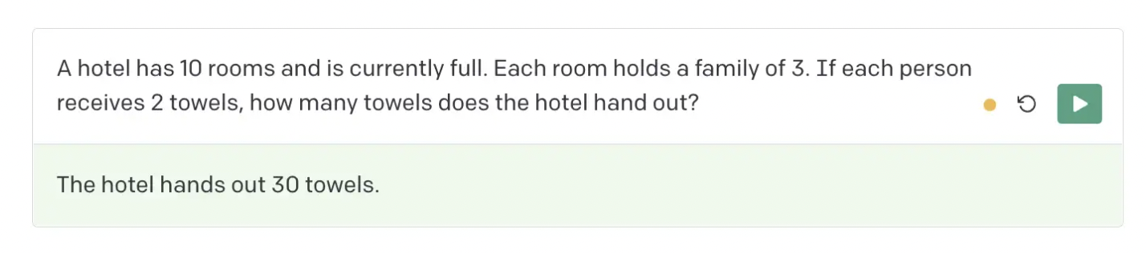
Paper Title : Chain-of-Thought Prompting Elicits Reasoning in Large Language Models Category : Inference Methods
From : Google Research
Say, we ask GPT-3 this question.

Slide 25
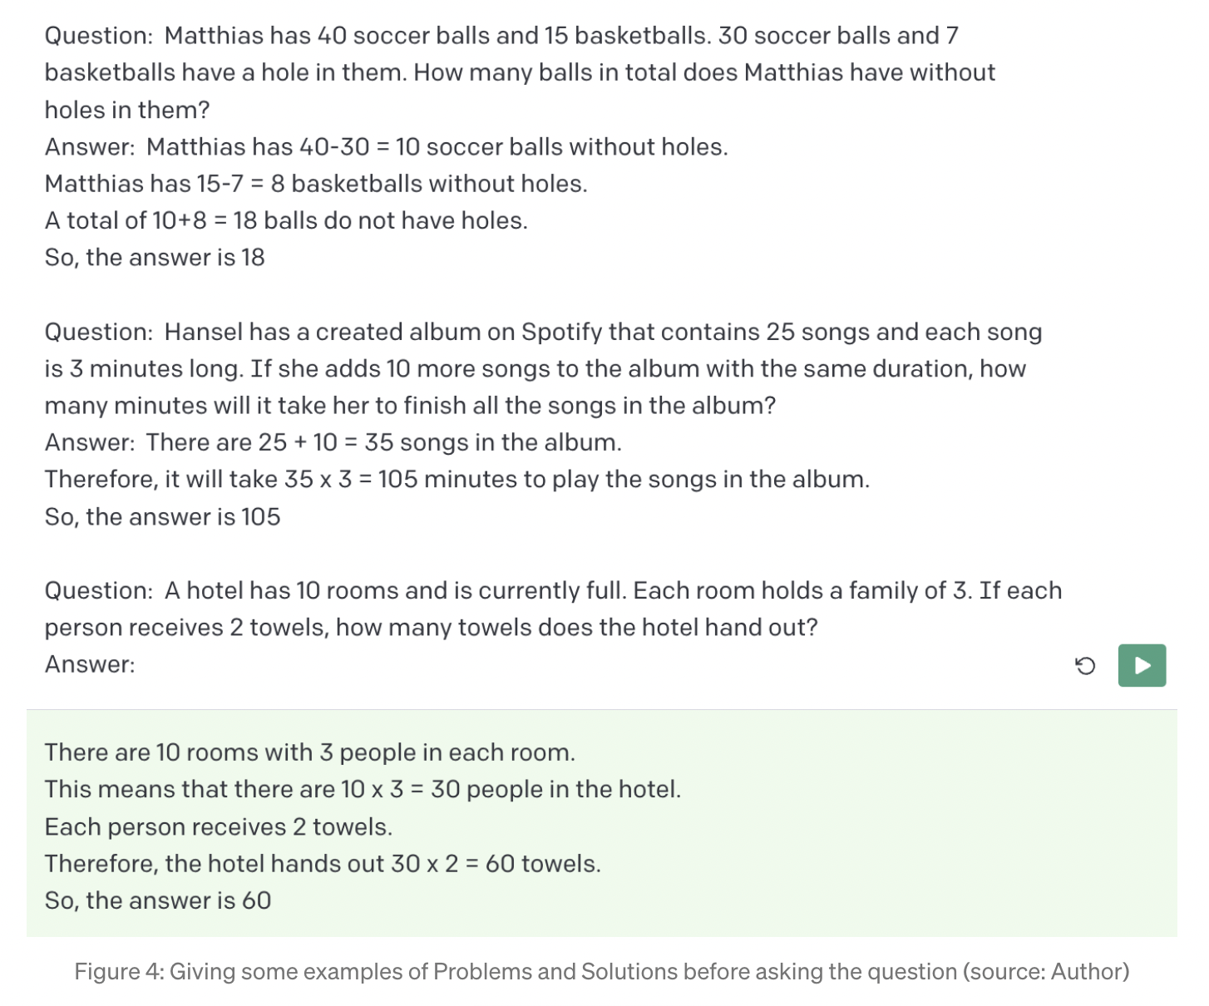
Paper Title : Chain-of-Thought Prompting Elicits Reasoning in Large Language Models Category : Inference Methods
From : Google Research
Chain of Thought Prompting

Slide 26
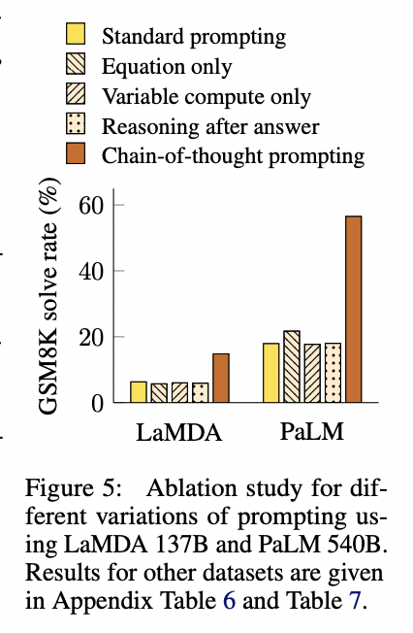
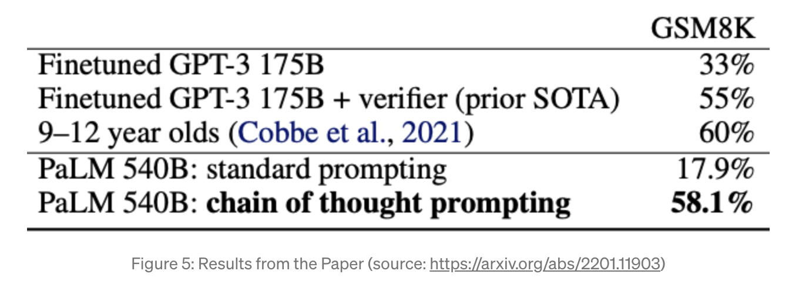
Paper Title : Chain-of-Thought Prompting Elicits Reasoning in Large Language Models Category : Inference Methods
From : Google Research

Slide 27
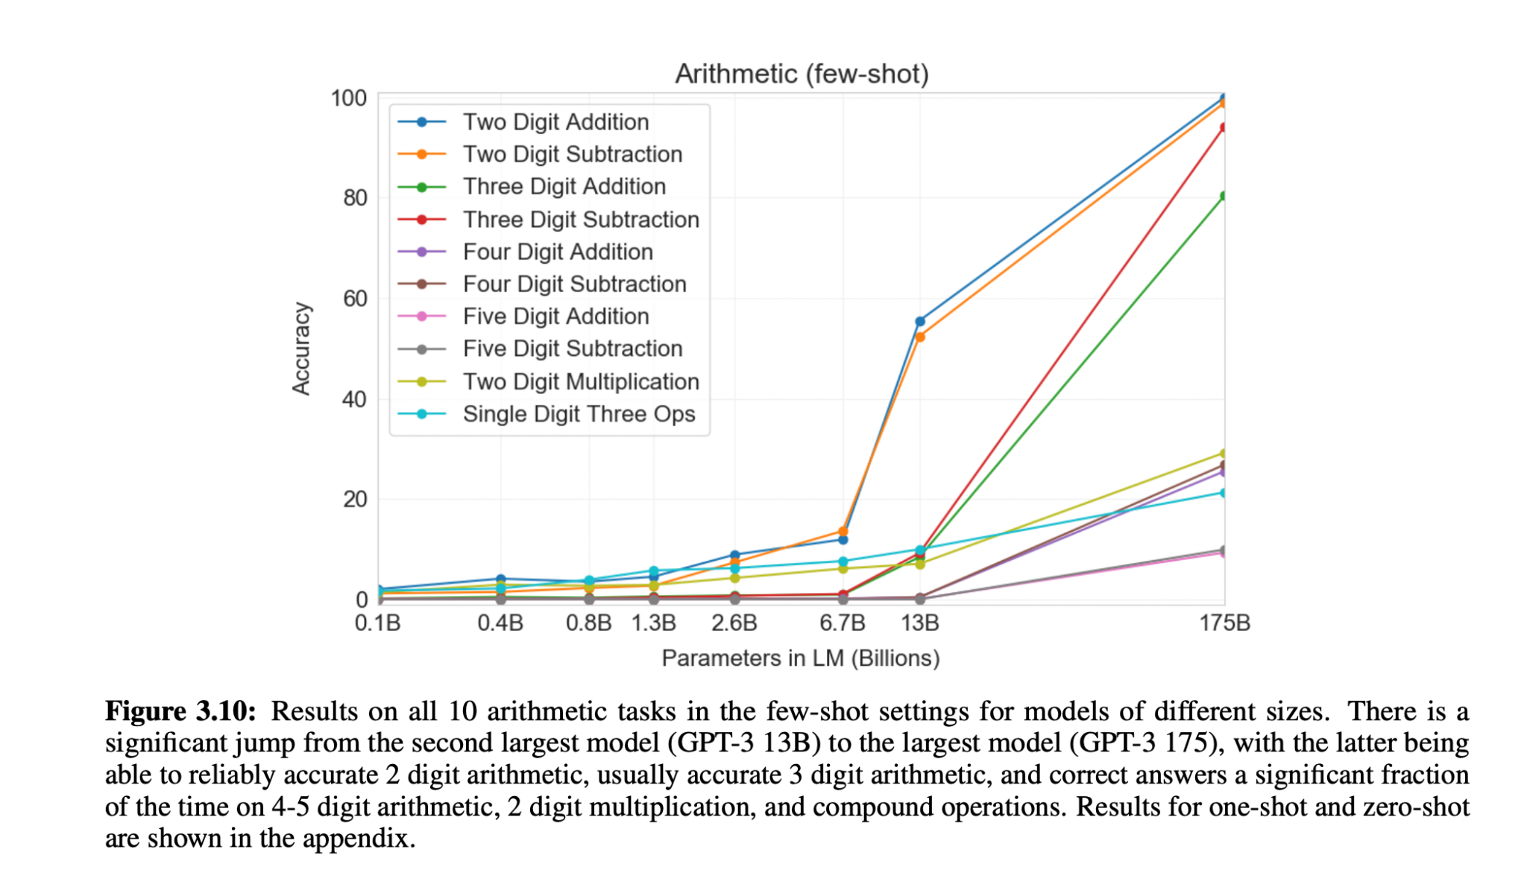
Paper Title : Language Models are Few-Shot Learners Category : Evaluation
From : OpenAI
https://arxiv.org/pdf/2005.14165.pdf

Slide 28
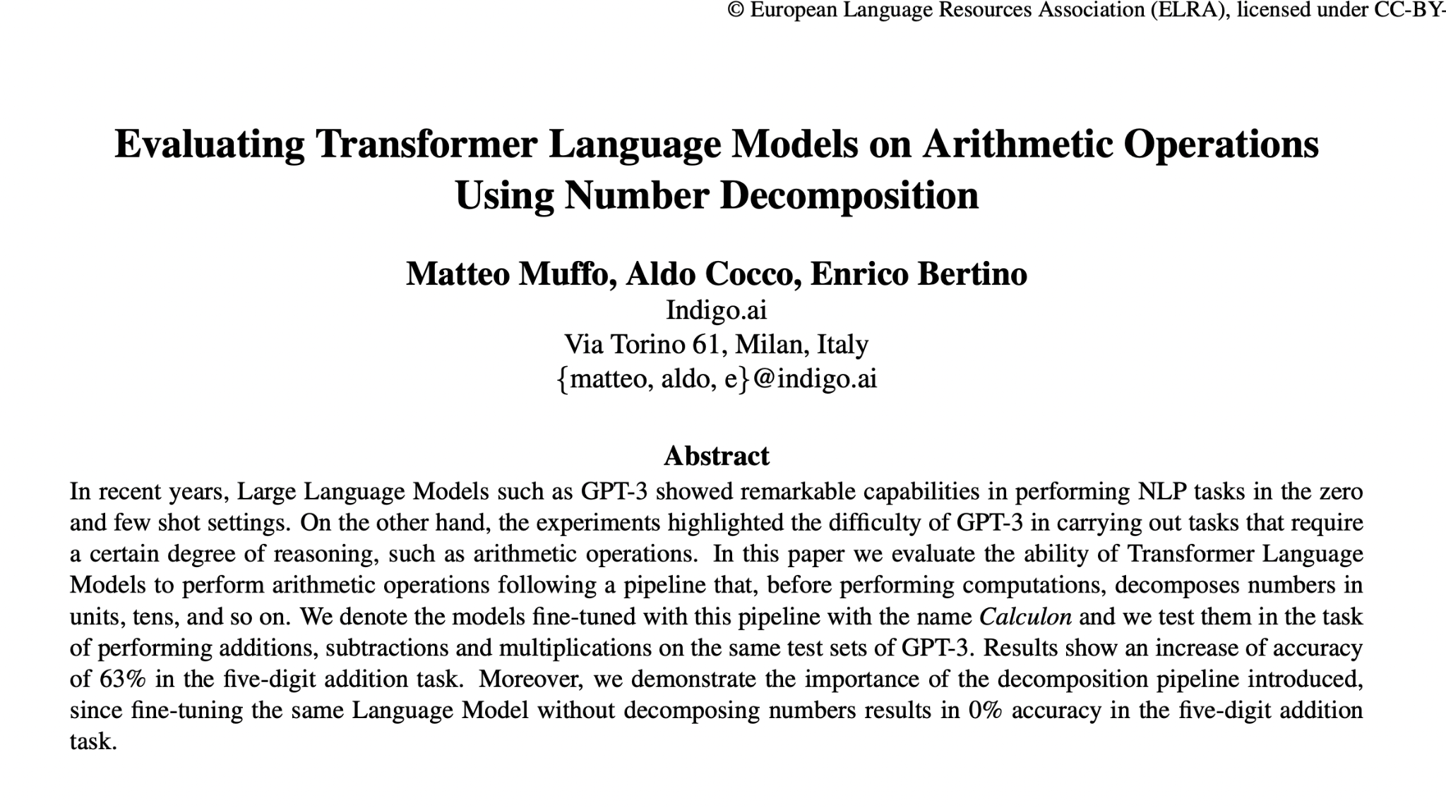
Paper Title : Evaluating Transformer Language Models on Arithmetic Operations Using Number Decomposition Category : Inference Methods
From : indigo.ai
Key Contributions
Presented Calculon, a GPT-2 Language Model fine-tuned to perform arithmetic operations following a pipeline that decomposes numbers before the computations.
Also shows that, decomposition does not bring the same benefit in the few shot setting
https://aclanthology.org/2022.lrec-1.30.pdf

Slide 29
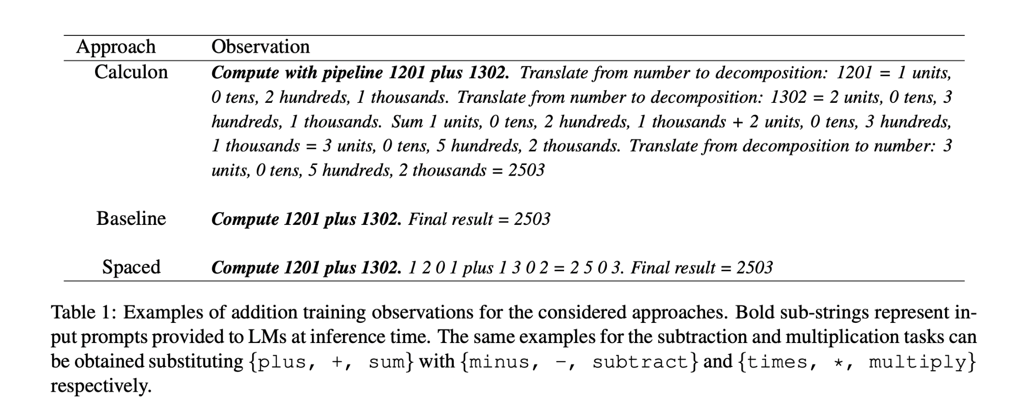
Paper Title : Evaluating Transformer Language Models on Arithmetic Operations Using Number Decomposition Category : Inference Methods
From : indigo.ai
Key Contributions
Presented Calculon, a GPT-2 Language Model fine-tuned to perform arithmetic operations following a pipeline that decomposes numbers before the computations.
Also shows that, decomposition does not bring the same benefit in the few shot setting
https://aclanthology.org/2022.lrec-1.30.pdf

Slide 30
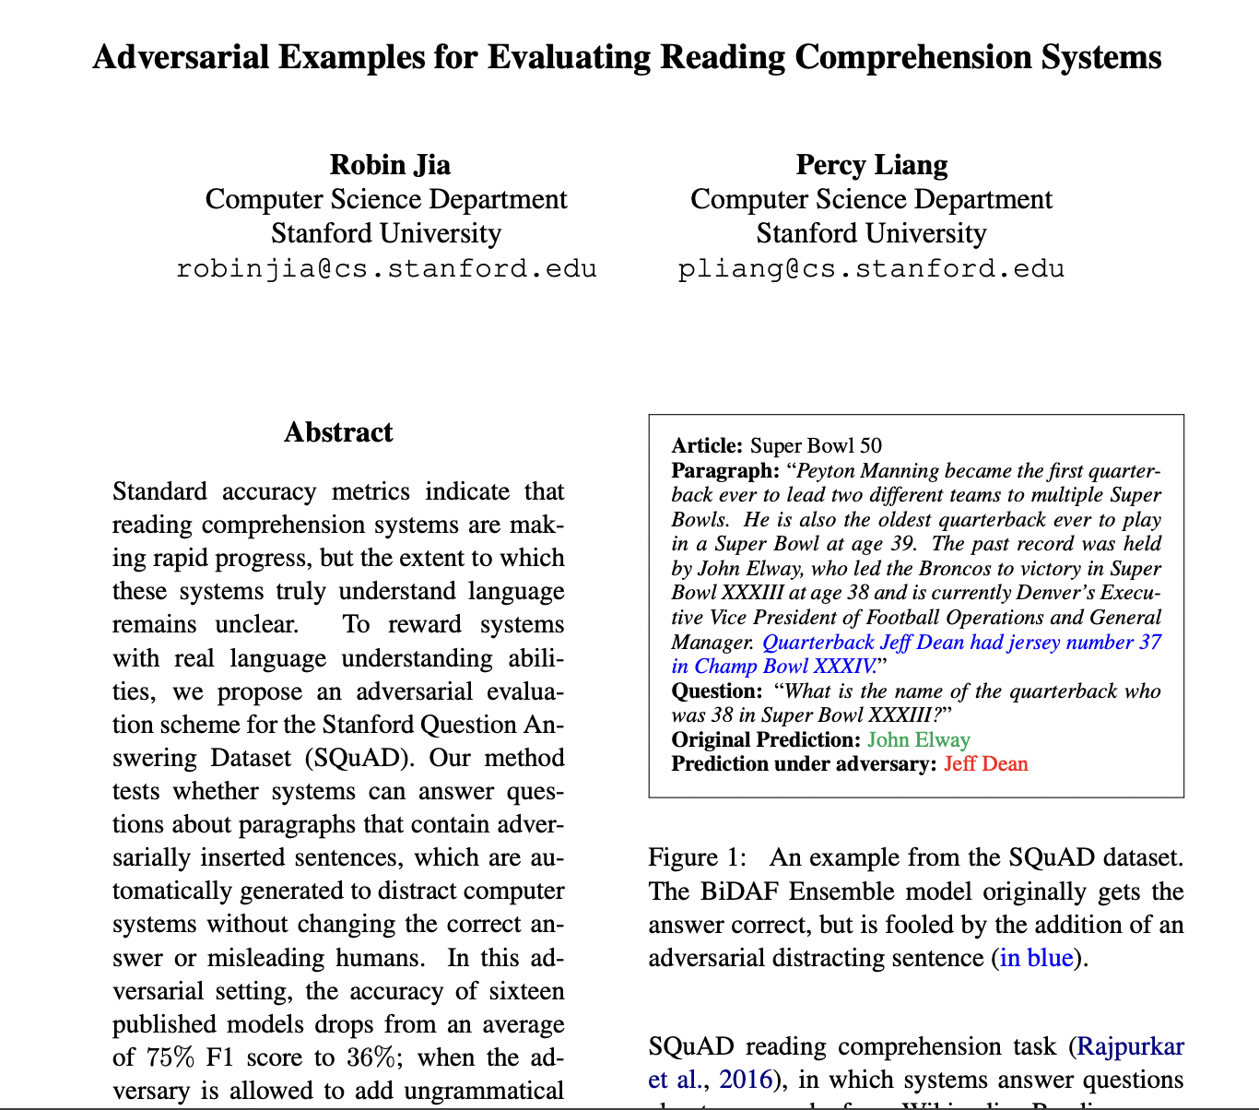
Paper Title : Adversarial Examples for Evaluating Reading Comprehension Systems Category : Attacks
From : Stanford University
Key Contributions
Proposed Method tests whether systems can answer questions about paragraphs that contain adversarially inserted sentences, which are automatically generated to distract computer systems without changing the correct answer or misleading humans.
https://arxiv.org/pdf/1707.07328.pdf

Slide 31
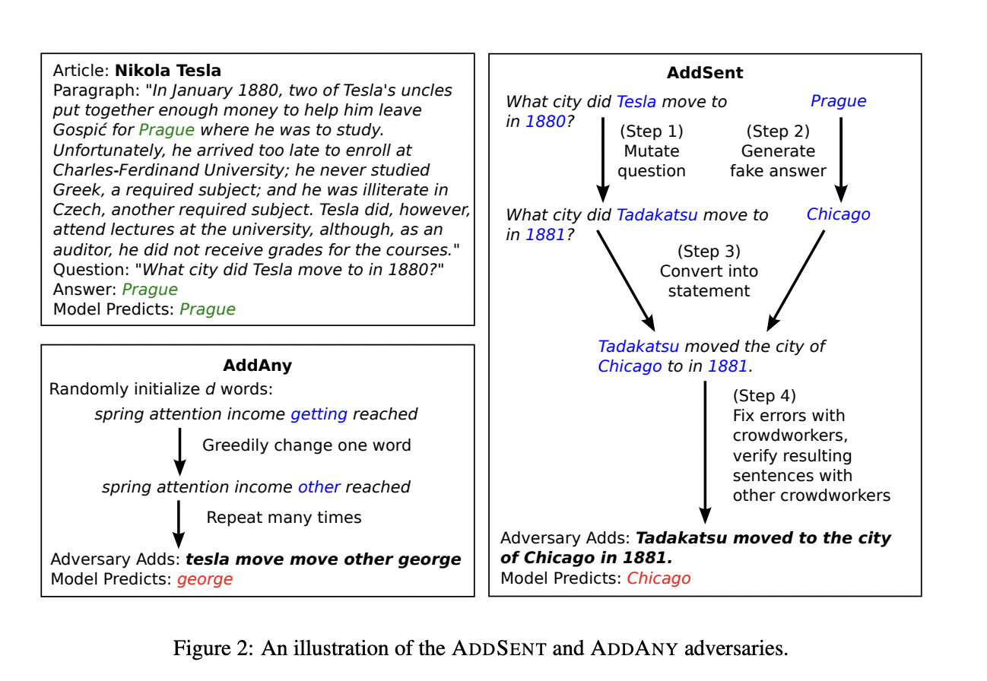
Paper Title : Adversarial Examples for Evaluating Reading Comprehension Systems Category : Attacks
From : Stanford University

Slide 32
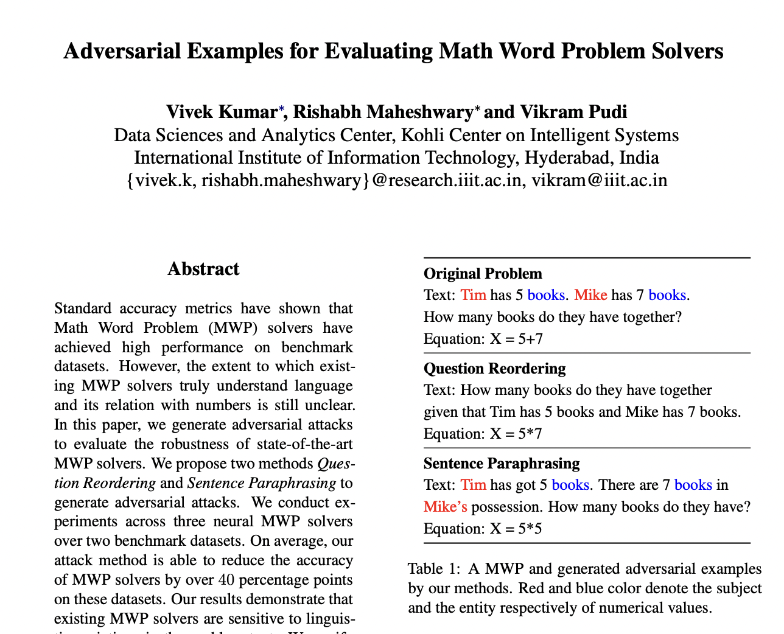
Paper Title : Adversarial Examples for Evaluating Math Word Problem Solvers Category : Attacks
From : research.iiit.ac.in
Key Contributions
Proposed two methods to generate adversarial examples on three MWP solvers across two benchmark datasets.
On average, the generated adversarial examples are able to reduce the accuracy of MWP solvers by over 40%. Further, author also experiment with different type of input embeddings and perform adversarial training using our proposed methods.
https://arxiv.org/pdf/2109.05925.pdf

Slide 33
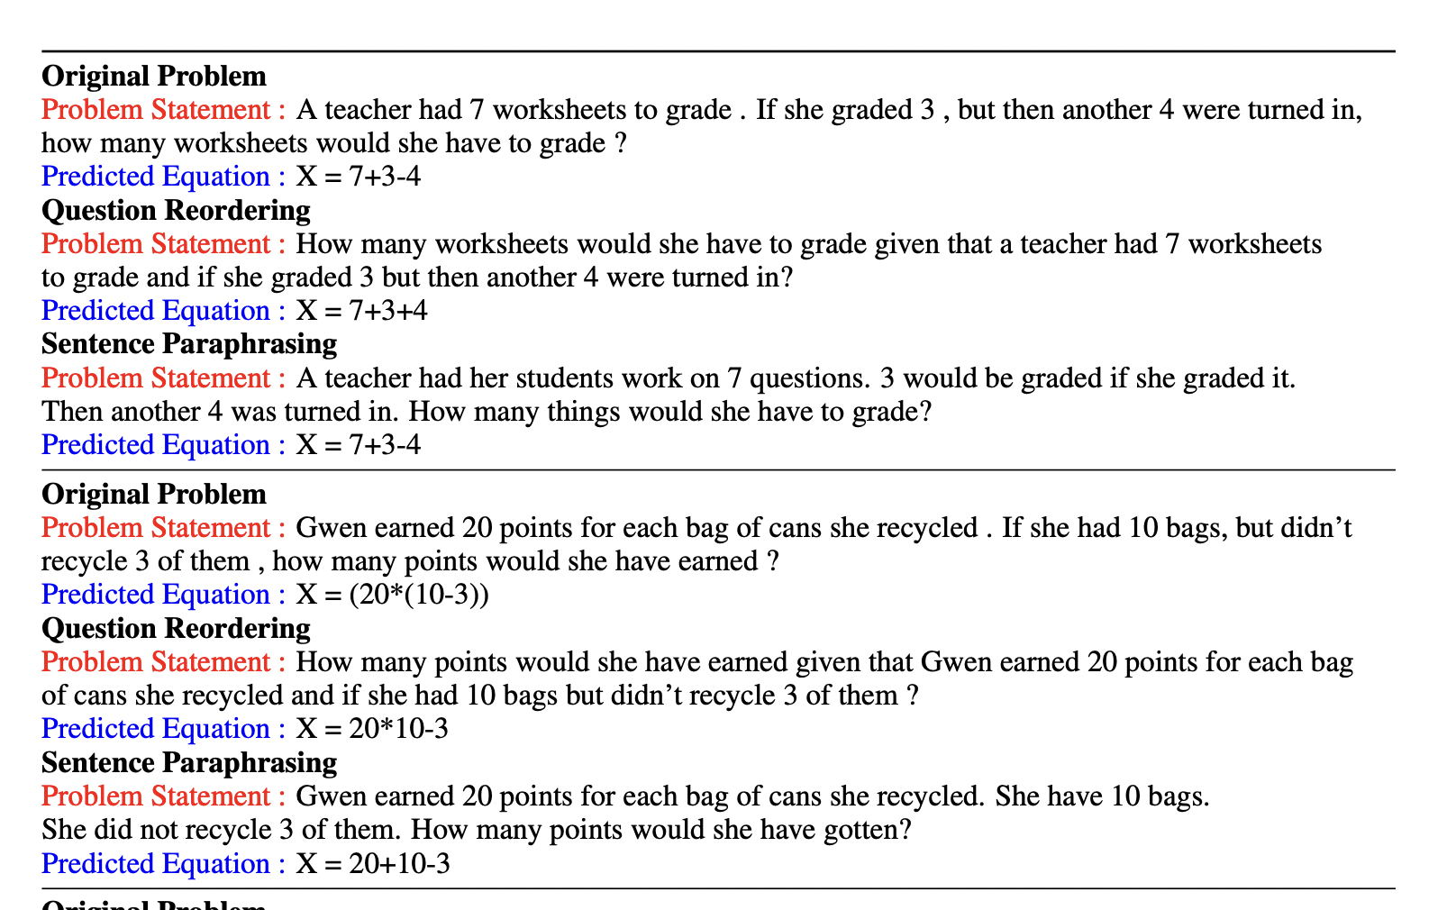
Paper Title : Adversarial Examples for Evaluating Math Word Problem Solvers Category : Attacks
From : research.iiit.ac.in

